Slide 1
Hospital Management System
Name: Saraswati BIsht
Employee id: 186560

Slide 2
Introduction
This Project Presents Hospital Management System.
It has Three Phases, Console Application, WPF Application, MVC.
It Contains functionalities.
Add Patient .
Display Patient Records.
Search Patients.
Show Patient History.
Create Lab Report.
Display Lab Report.
Display Doctors List.
Generate Medical Bill.

Slide 3
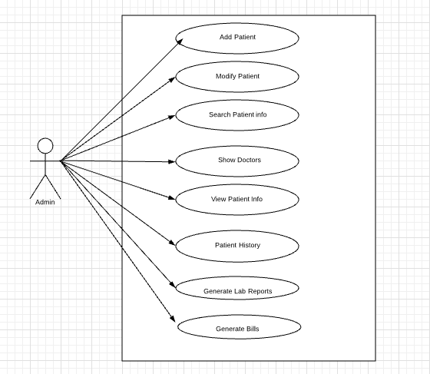
Use Case Diagram

Slide 4
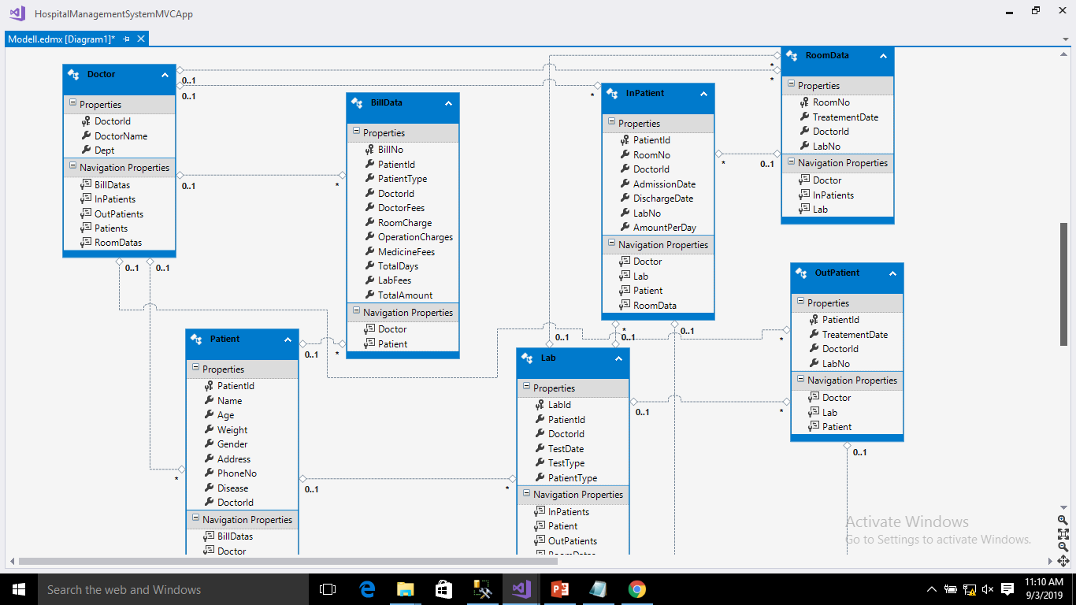
Class Diagram

Slide 5
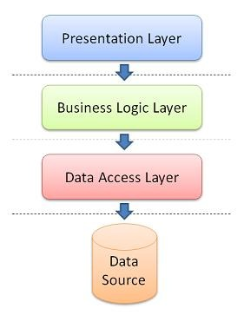
Architecture of Console And WPF

Slide 6
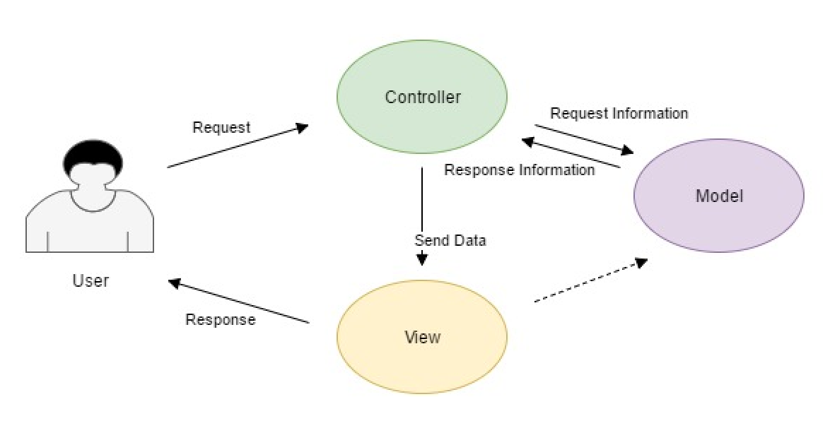
Architecture of MVC

Slide 7
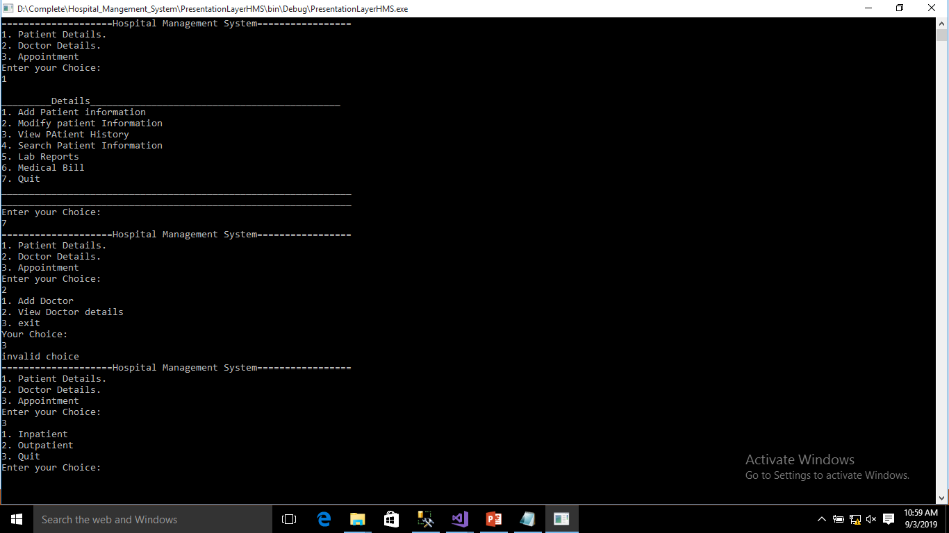
Phase 1 - Screenshots

Slide 8
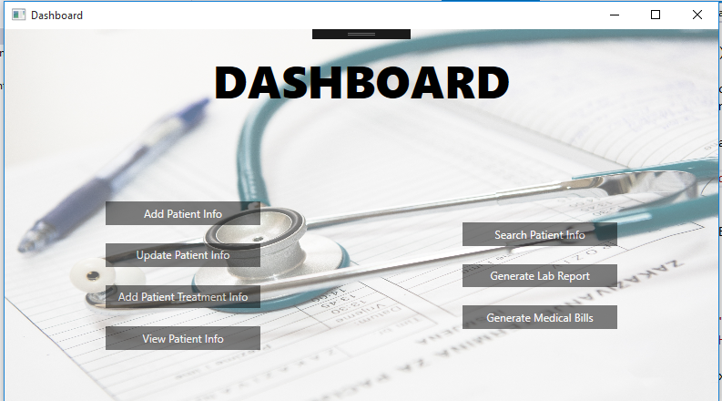
Phase 2 - Screenshots

Slide 9
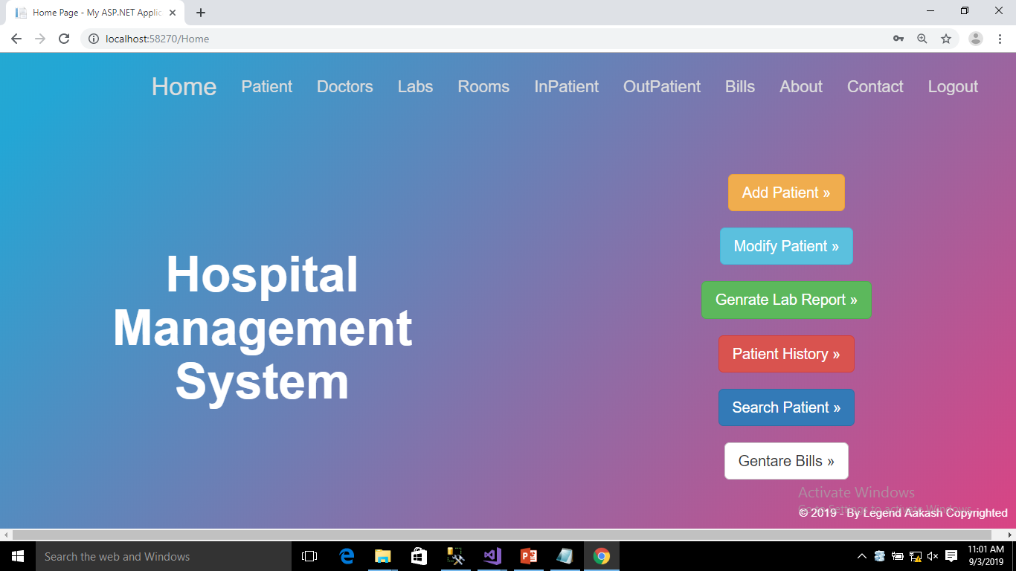
Phase 3 - Screenshots

Slide 10
Future Enhancement
Registration for the user.
Method to Make Appointment with Particular Doctor.
More Dynamic With Bootstrap features.
Testing Methods.

Slide 11
Thanks

